Slide 1

SUPERMARKET SALES DATASET
_ Aarthi
Data analytics batch sep 2025

Slide 2
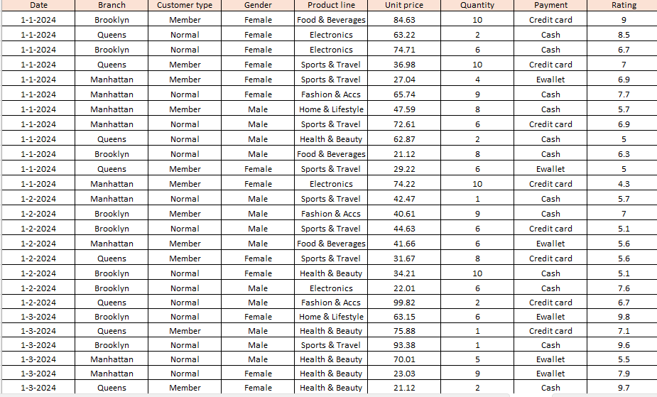
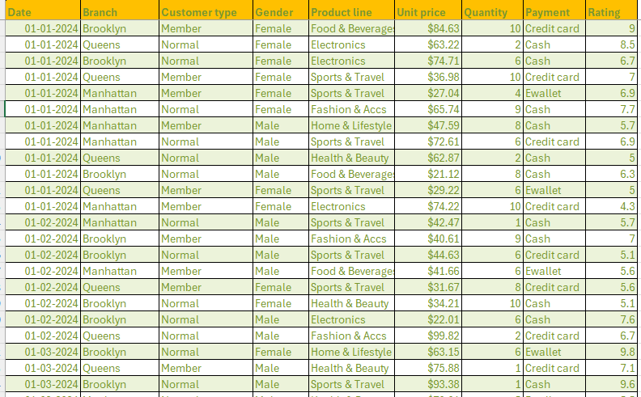
Data Description and Preparation
Data Source: Kaggle Supermarket Sales Dataset.
Dataset Overview: 5054rows, 9 columns (Date, Branch ,Gender ,Product line, Customer type, Unit price, Quantity,Payment, Rating)
Date Cleaning:
Removed duplicates.(None found)
Applied Currency Formatting.
RAW DATA
CLEAN DATA

Slide 3
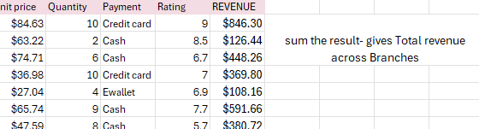
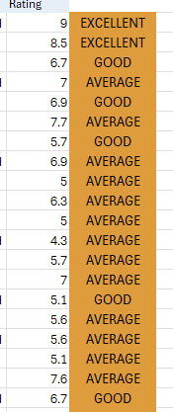

Formula and Calculation
Calculation:
Revenue :( sum(unit price* Quantity)).
Formula:
Rating segmentation:
Excellent: Rating 9-10
Good: Rating 7-8
Average: Rating <6
IF CONDITION and XLOOKUP.
Fetch GENDER/CUSTOMER TYPE for a branch.

Slide 4
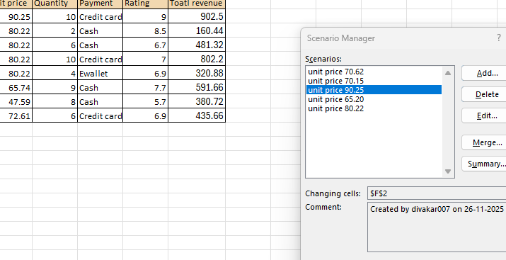
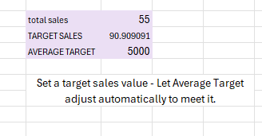
WHAT-IF ANALYSIS and GOAL SEEK
SCENARIO SUMMARY:
Goal:
Evaluate how changing unit price affects Total revenue.
GOAL SEEK:
Achieving target sales (avg.Target Adjustment)

Slide 5
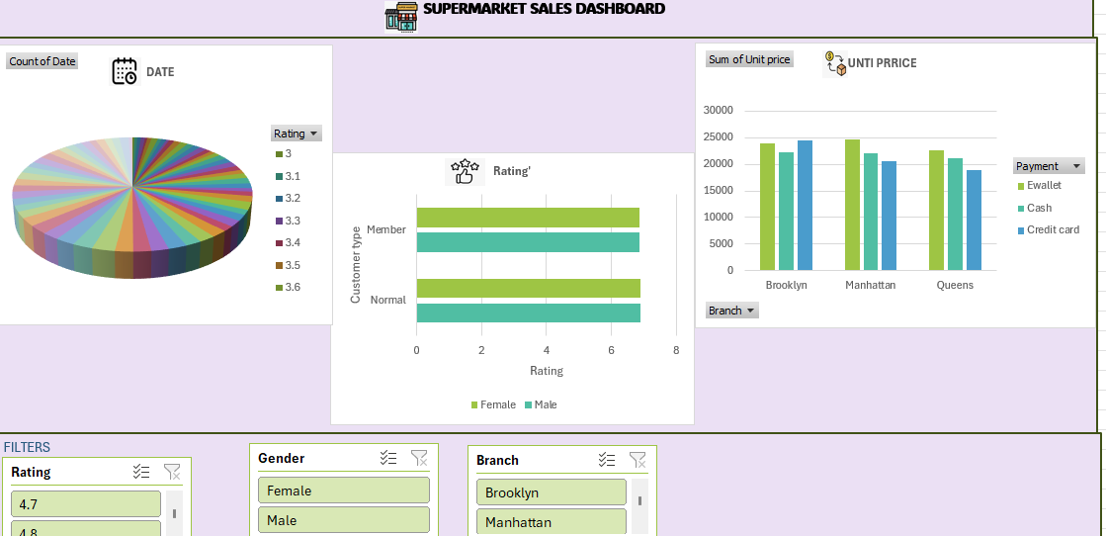
DASHBOARD OVERVIEW
Rating split by Date-see how satisfaction moves over time.
Average Rating by customer type and gender- spot which segment is happiest.
Unit price by Branch and payment method-check where revenue and payment mix differ.

Slide 6
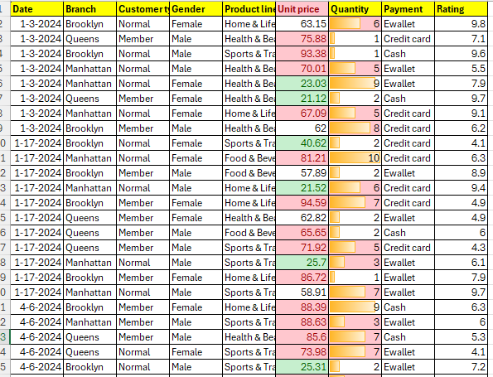
Macros and Automatic
Macro used:
Format sheet: Applied formatting ( Conditional formatting , Greater then & less then).
BENEFITS: Saves time,Ensure consistency.

Slide 7
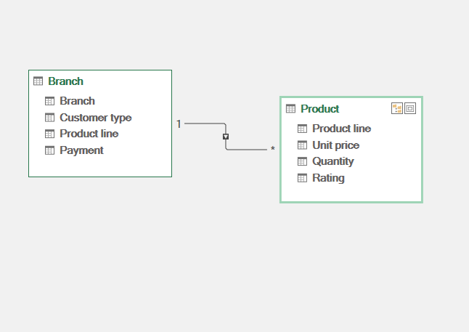
POWER PIVOT
I created these two power pivot tables to bring together.
Product-level financial and satisfaction metrics(unit price,quantity,rating)
Branch-level contextual data(customer type,payment method).

Slide 8
INSIGHTS AND RECOMMENDATIONS
INSIGHTS:
Branch B has the highest unit price($93)but lower Quantity ,pulling down overall volume.
Member customers(corporate/Retails)gives 12% higher average rating across all branches.
Recommendation:
  Introduce premium product bundles in branch B toboost margin while keeping volume stable.
  Launch a quick membership push in low-rating branches(B&D)with a 5%first purchase discount.

Slide 9
THANK YOU

